Slide 1
World Population Analysis
This project analyzes global population trends from 1970 to 2022 using Python. We explore how population growth, density, and distribution vary across countries and continents. Using data visualization tools, we uncover key insights about the world’s most and least populated regions, growth rates, and shifts in global demographics.
An Interactive Exploration of Global Population Trends
--By Shaik Naveed

Slide 2
Problem Statement
The world’s population has seen rapid growth over the last five decades, with significant variation across countries and continents. This uneven growth impacts resource distribution, urban planning, economic development, and environmental sustainability. Without a clear understanding of these population dynamics, it becomes challenging for governments, organizations, and planners to make informed decisions.
This project addresses the need to analyze and visualize global population trends from 1970 to 2022. By examining population size, growth rates, density, and regional distribution, we aim to uncover meaningful insights and patterns that highlight how the world’s demographics are shifting over time. The analysis will provide a data-driven foundation for understanding global population challenges and opportunities.

Slide 3
Technologies Used
Tool / Library | Purpose
Python | Core programming language for data analysis
Pandas | Data cleaning, transformation, and aggregation
Matplotlib | Basic visualizations (bar, line, pie charts)
Seaborn | Statistical visualizations and heatmaps
Plotly | Interactive and geographical visualizations
Google colab Notebook | Interactive coding, data exploration
CSV File | Source of the population dataset

Slide 4
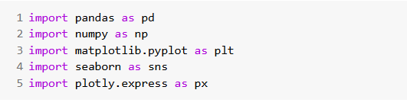

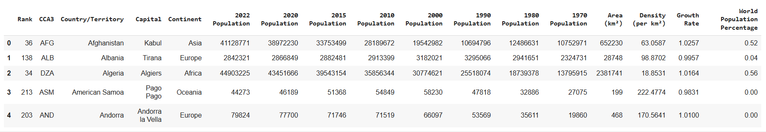
01
Data Cleaning
Step 1- importing libraries and reading data

Slide 5
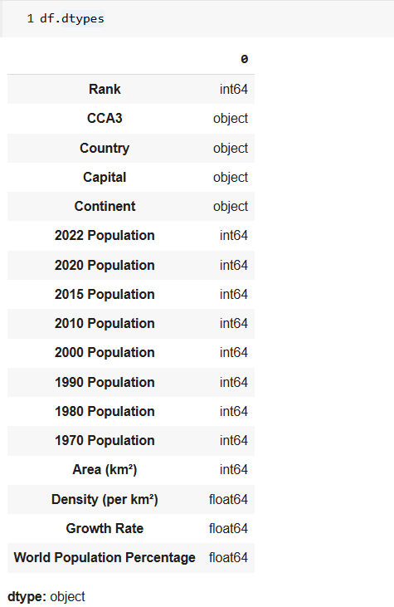
Step 2- Checking Data Types

Slide 6
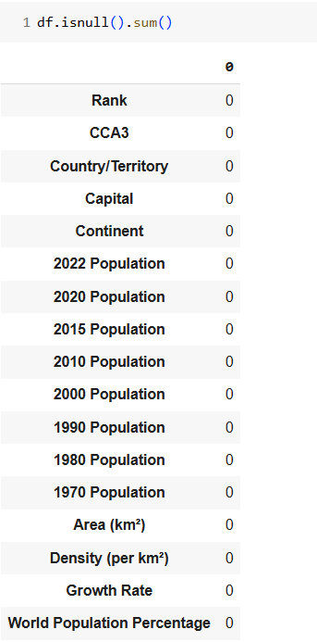
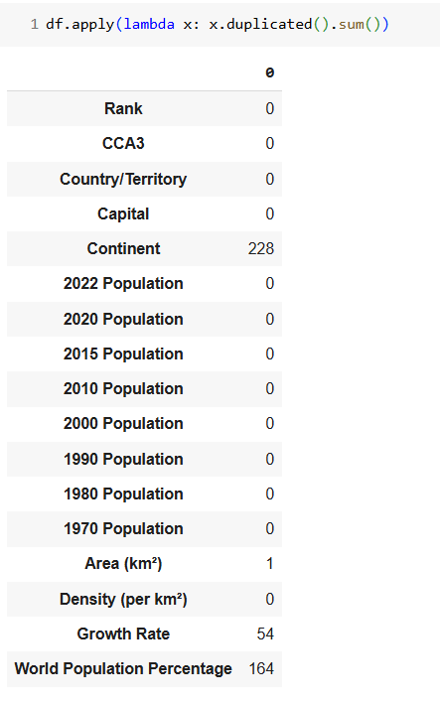
Step 3- Finding null values and Duplicates

Slide 7
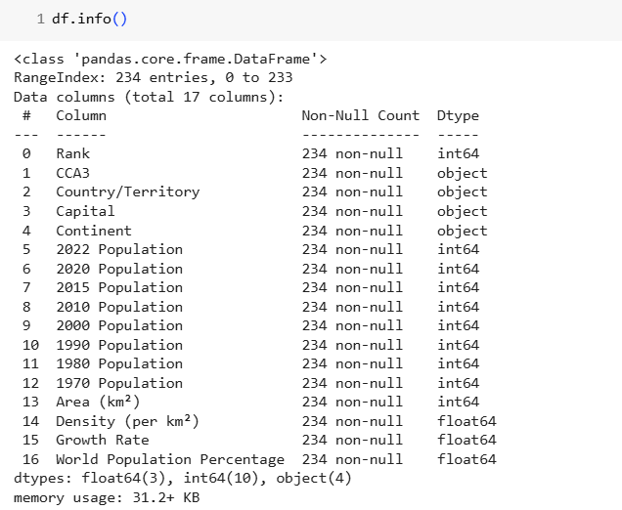
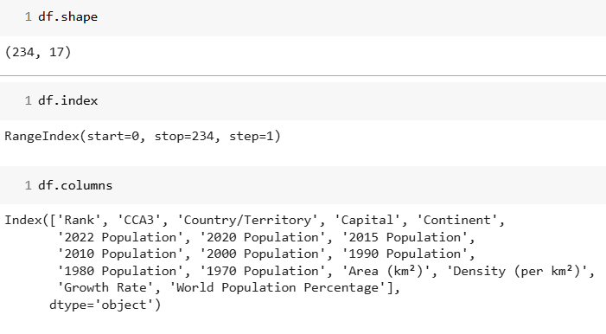
Step 3 – Changing Column name & Info of Data

Slide 8

02
Data Visualization
Data Insights

Slide 9
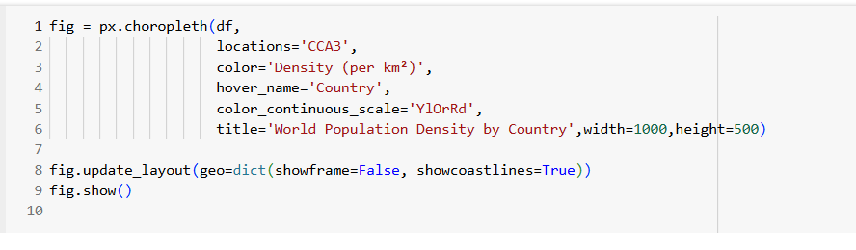
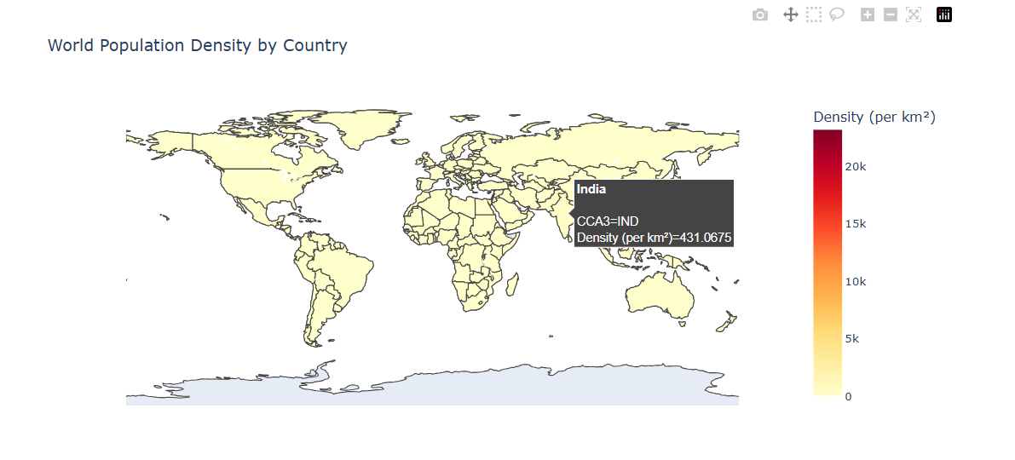
1) Map of Population Density

Slide 10
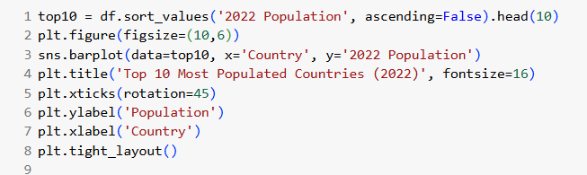
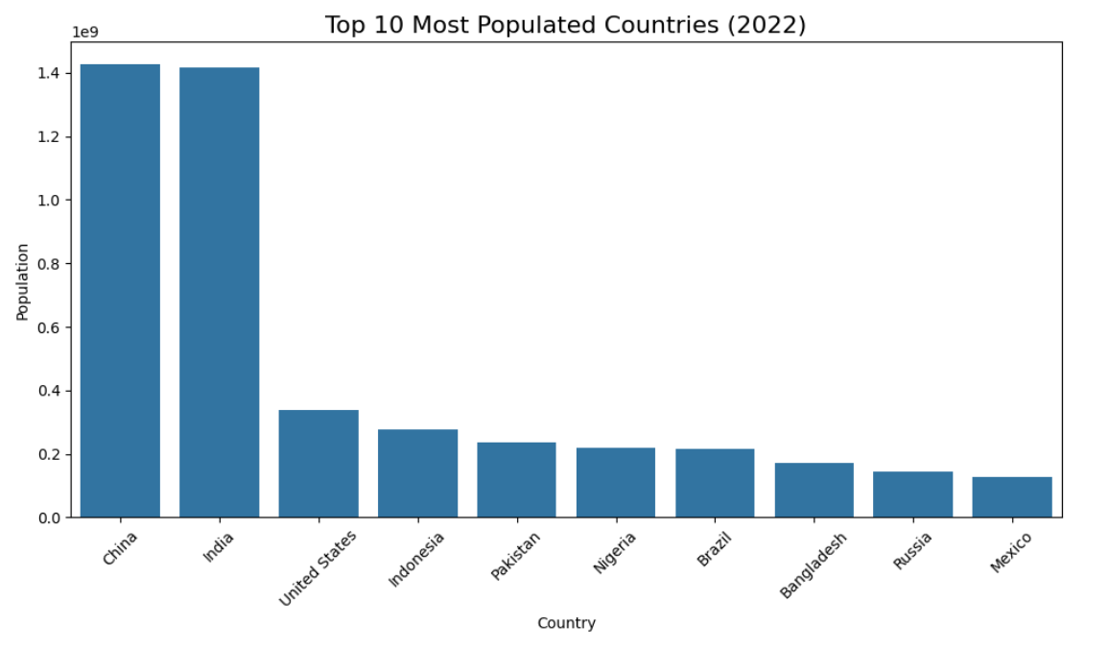
2) Top 10 Most Populated Countries in 2022

Slide 11
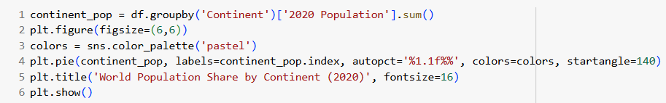
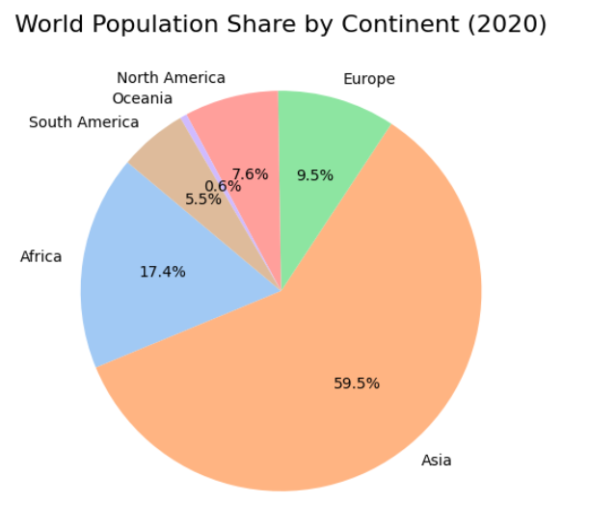
3) Population Share by Continent

Slide 12
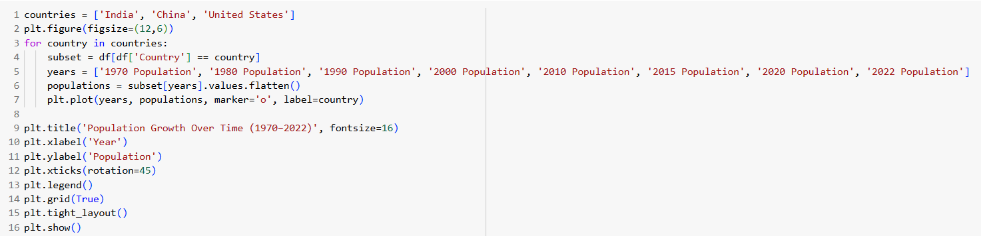
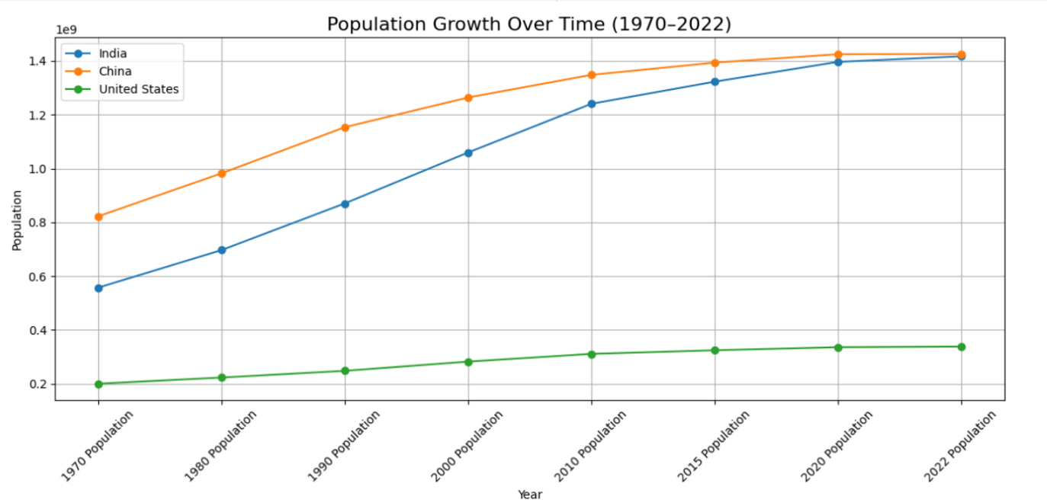
4) Population Growth Trend in India, China, USA

Slide 13
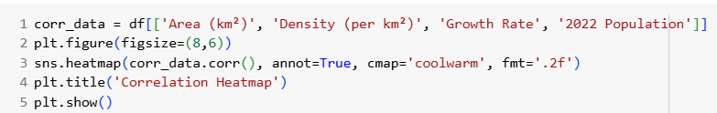
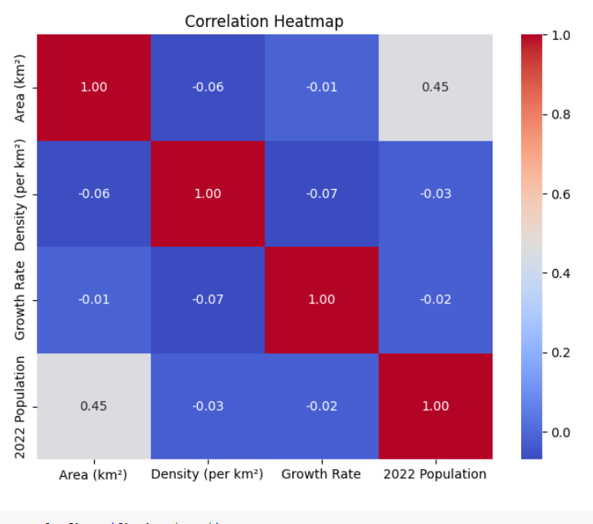
5) Area Wise Density and Growth Rate

Slide 14
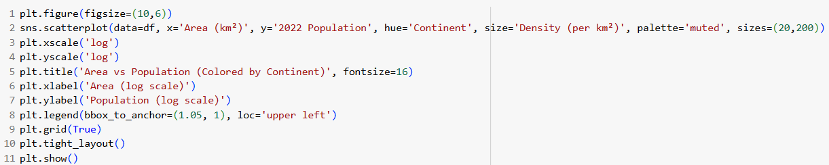
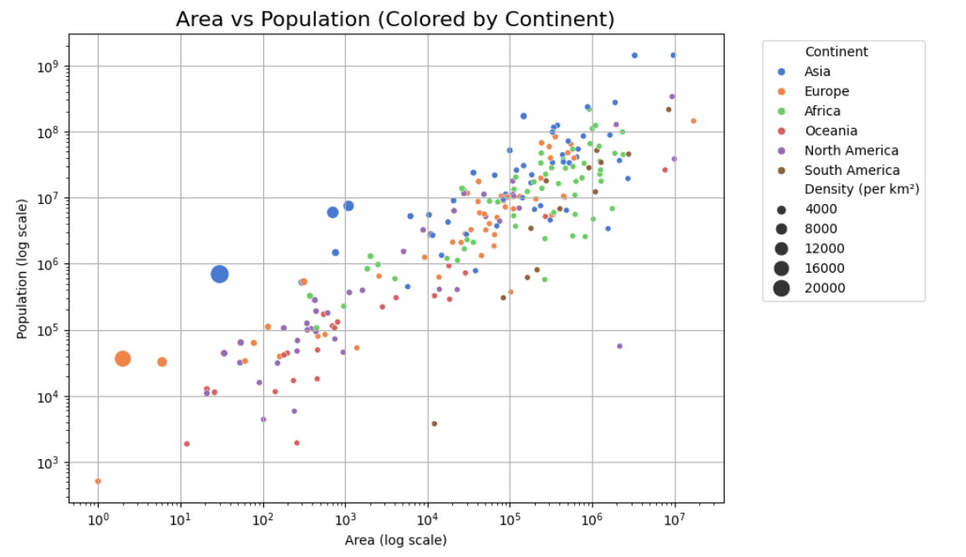
6)Area vs Population

Slide 15
Conclusion
This project provided a comprehensive analysis of global population trends from 1970 to 2022. Through data visualization and statistical exploration, we uncovered key insights into how the world’s population is distributed, how rapidly it's growing in different regions, and which countries dominate in terms of size and density.
Some major takeaways include:
Asia continues to hold the majority of the world’s population.
Africa shows the fastest growth rate, indicating future demographic shifts.
Population density does not always correlate with land area, highlighting urban concentration challenges.
The top 10 countries account for a significant portion of the total global population.

Slide 16

Thank you!
Do you have any questions?

